Slide 1
Real Estate price prediction

Slide 2
TEAM MEMBERS
S.NO | NAME | ROLL.NO
1 | SANDEEP | 2110030196
2 | ABHINAV | 2110030159
3 | HARISH | 2110030134

Slide 3
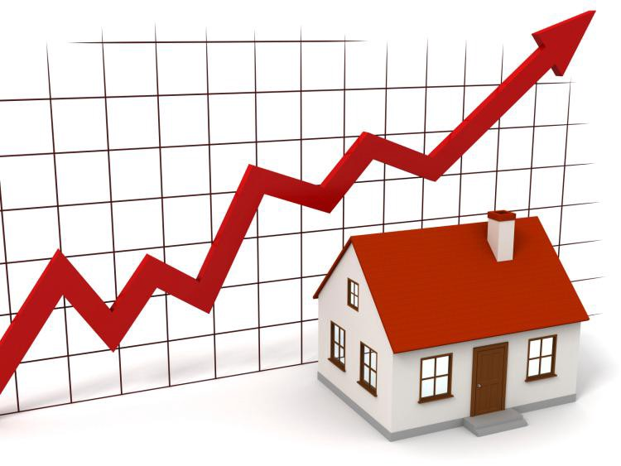
Outline
Introduction
Problem statement
objective
Scope of the project
Requirement analysis
Testing
Dataset
Conclusion
References

Slide 4

Introduction
Real estate price prediction has become an important area of research due to the significant impact it has on the economy and society.
Accurate prediction of real estate prices can help buyers and sellers make informed decisions, and can also aid policymakers in developing effective housing policies.
Machine learning models can provide accurate predictions, and that location and property characteristics are key factors influencing real estate prices.

Slide 5
Problem statement
Prices of real estate properties are sophisticatedly linked with our economy.
Despite this, we do not have accurate measures of house prices based on the vast amount of data available.
Proper and justified prices of properties can bring in a lot of transparency and trust back to the real estate industry, which is very important for most consumers especially in India.

Slide 6
Literature survey
Machine learning applies in Real estate price prediction.
A large number of scholars have participated to this work on the analysis of house price prediction in the past.

Slide 7
OBJECTIVE
The objective of real estate price prediction is to forecast the future value of a property based on various factors such as location, market trends, economic conditions. This information is crucial for buyers, sellers, investors, and real estate professionals who want to make informed decisions about buying, selling, or investing in properties.
The objective of real estate price prediction is to provide accurate and reliable information to all stakeholders involved in the real estate industry, enabling them to make informed decisions and maximize their returns.

Slide 8
Software & Hardware Requirements
HARDWARE REQUIREMENTS:
High-performance CPU or GPU
Sufficient RAM to handle large data sets
Storage space to store the data set and trained models
Internet connectivity to access external data sources
SOFTWARE REQUIREMENTS:
Python programming language
Machine learning libraries such as Scikit-learn, TensorFlow, Keras, PyTorch, etc.
Data analysis and visualization tools such as Pandas, Matplotlib, Seaborn, etc.
Database management systems such as MySQL, PostgreSQL, MongoDB, etc.
Web frameworks such as Flask, Django, etc.

Slide 9
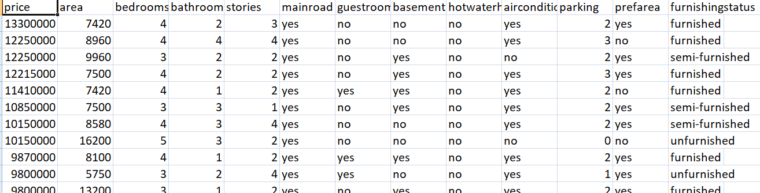
Dataset
This dataset comprises data that was scraped. It includes:
collection of prices of new and resale houses located in the metropolitan areas of India.
The amenities provided for each house.
https://www.kaggle.com/datasets/quantbruce/real-estate-price-prediction

Slide 10
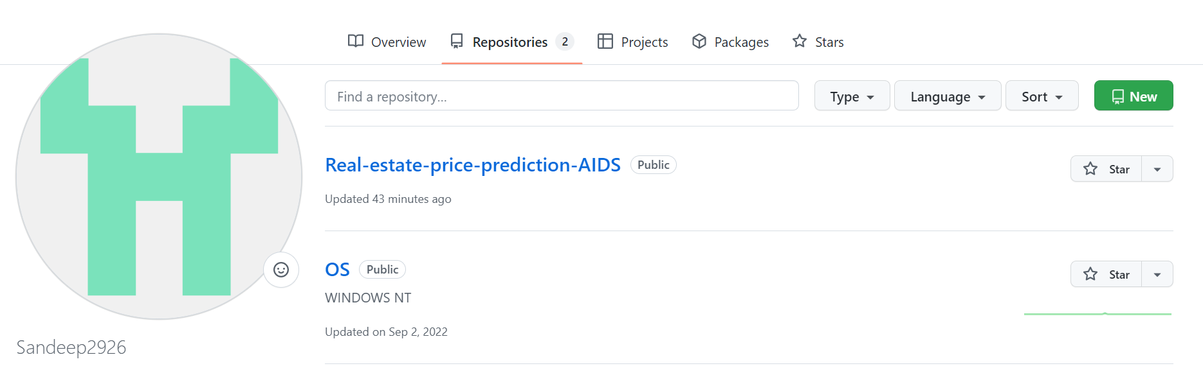
GITHUB SETUP

Slide 11
THANK YOU

